Slide 1
Viral bioinformatics
Introduction to
Philippe Le Mercier, Swiss-Prot group
23 January 2024, Geneva

Slide 2
Introduction to Viral Bioinformatics
Generalities
Virus resources/database
Viral genomics
Viral metagenomics
Viral Proteomics
Host-virus interactions

Slide 3
Disclaimer
The course focuses on virus-specific aspects of bioinformatics.
It does not cover the details of various techniques such as multiple sequence alignments, BLAST, HMM, Whole Genome (NGS) Sequencing, Principal Component Analysis (PCA), etc…

Slide 4
Introduction to Viral Bioinformatics
Generalities
Virus resources/database
Viral genomics
Viral metagenomics
Viral Proteomics
Host-virus interactions

Slide 5
Generalities
What is a virus
Virus taxonomy
Virus metadata

Slide 6
What is a virus?
“A virus is a mobile genetic element that codes for proteins but not for ribosome.”
Viruses appeared early,
as soon as ribosome emerged
( about 4 billion years ago)

Slide 7
Virosphere challenge
The virosphere may contain the greatest diversity known to mankind.
It has been estimated that there are 10³¹ viruses on Earth;
(10²⁴ stars in the Universe)
Billions of years of evolution with high mutatioin rate

Slide 8
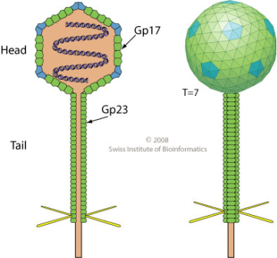
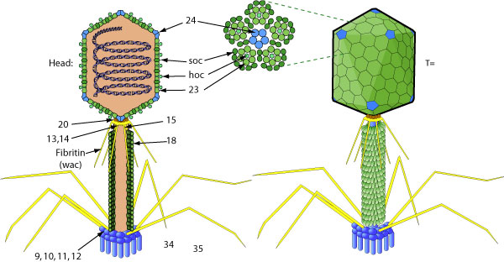
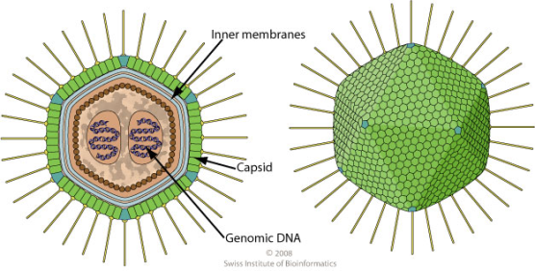
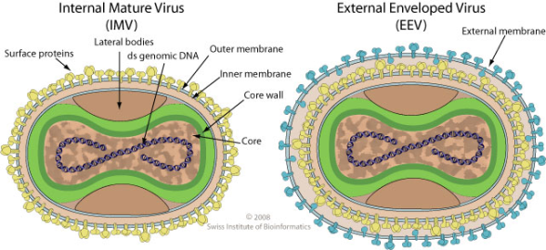
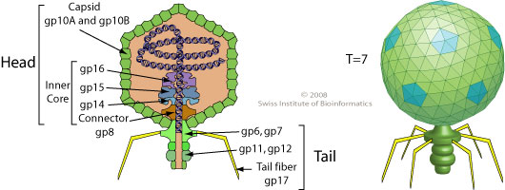
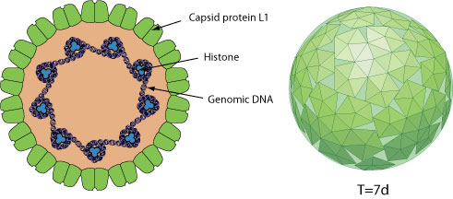
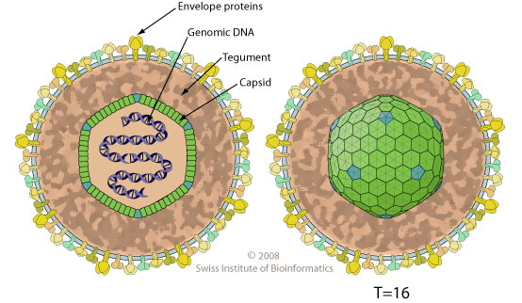
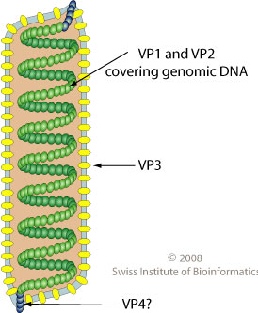
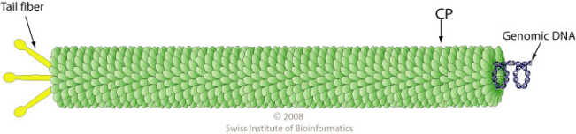
Diversity of Virions

Slide 9
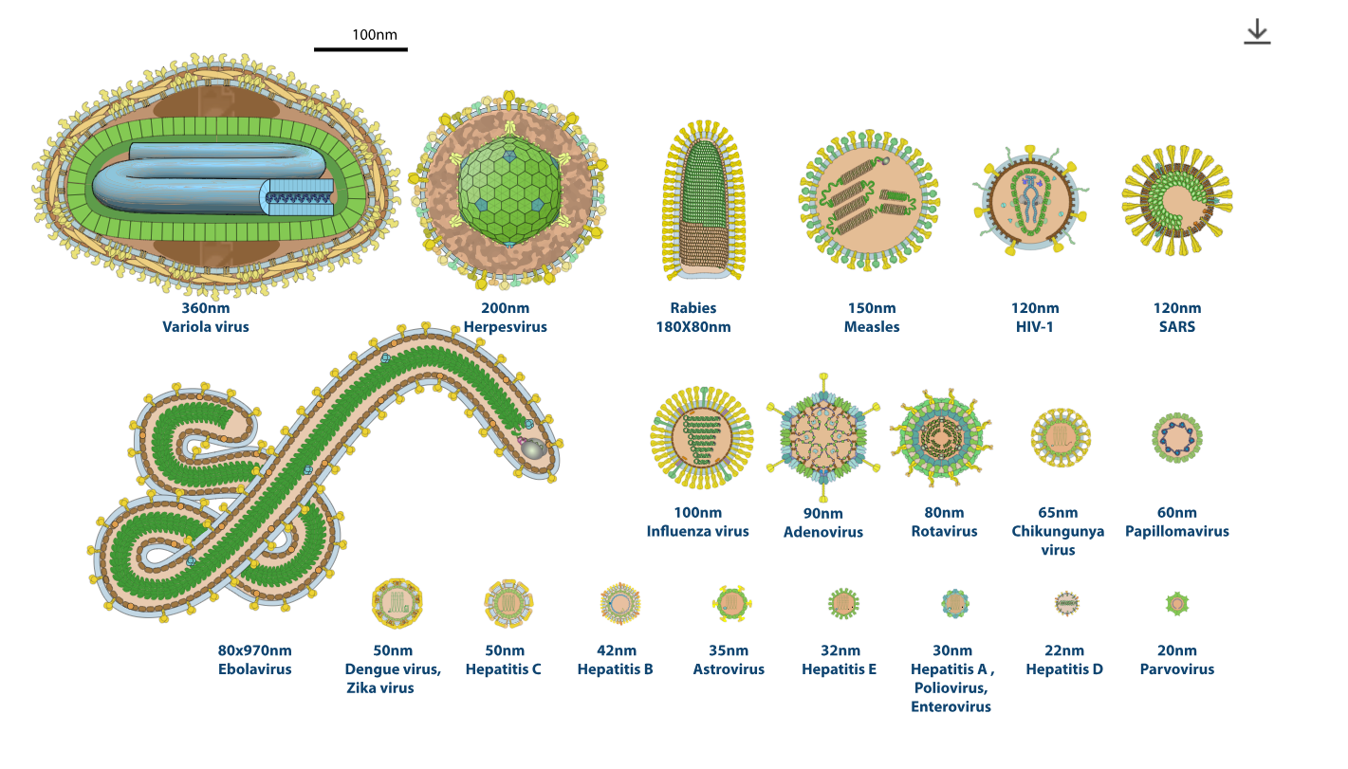
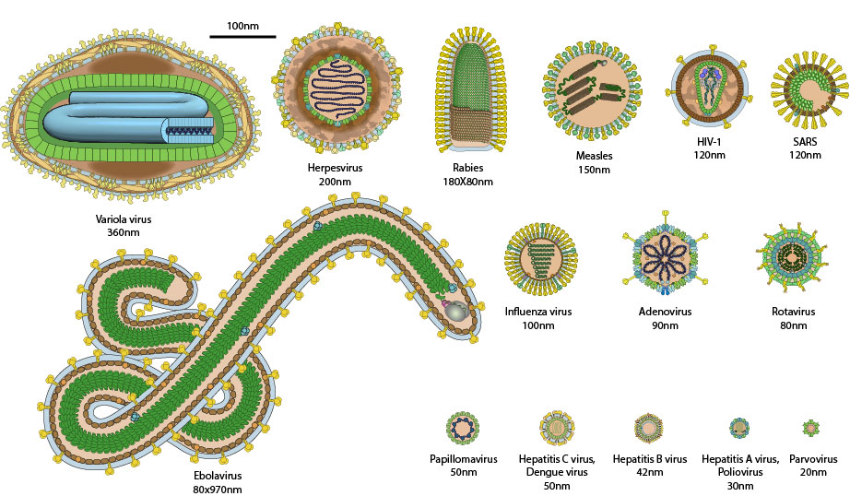
Human viruses

Slide 10
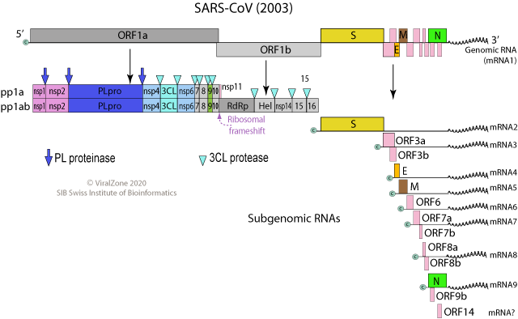
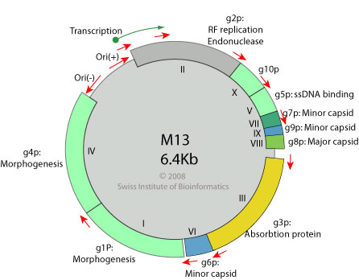
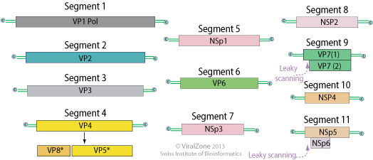
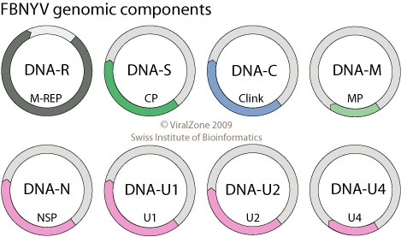
Viral genomes
LINEAR
CIRCULAR
SEGMENTED
Rotavirus

Slide 11
Virus bioinformatics
Powerful computational tools are needed to analyze this biodiversity
identify viral sequences and their encoded functional elements,
predict, annotate, and compare their functions, and
structure the data to move from measuring to understanding.
Viral bioinformatics
https://www.ncbi.nlm.nih.gov/pmc/articles/PMC7567488/

Slide 12
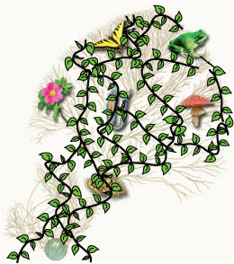

Viral Classification: Taxonomy
All virus information is classified relative to the taxonomy.
-The « tree of life » is relatively straightforward:
one trunk, many branches.
-Viruses would be much like ivy on a tree.

Slide 13
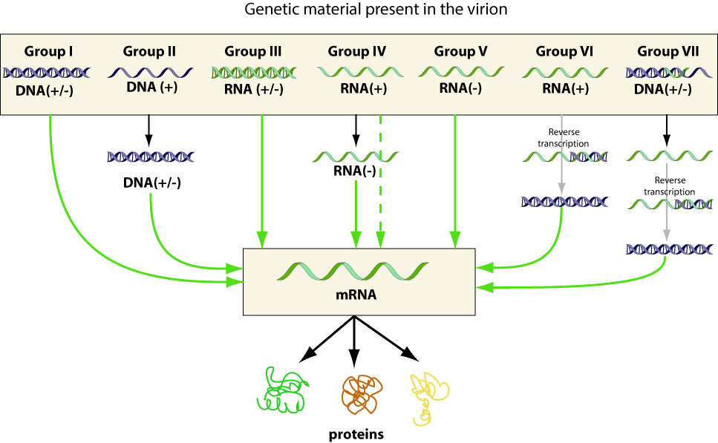

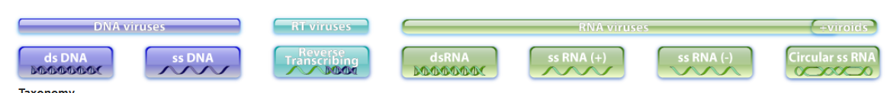
Baltimore classification
David
Baltimore

Slide 14
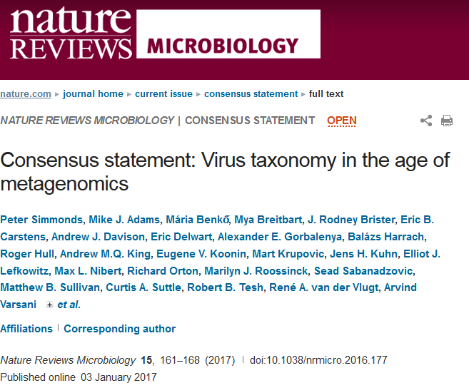
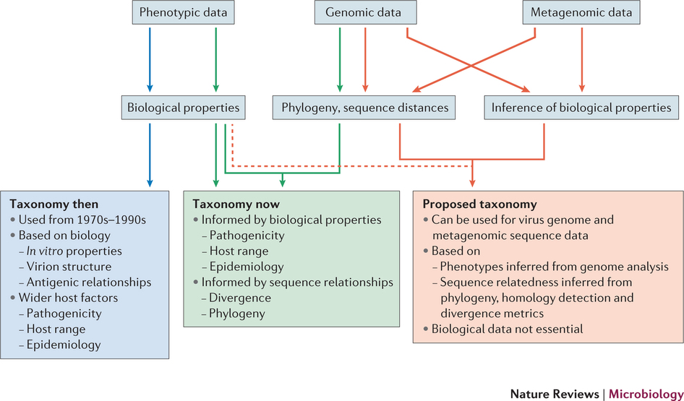
Toward new tools to establish virus taxonomy

Slide 15

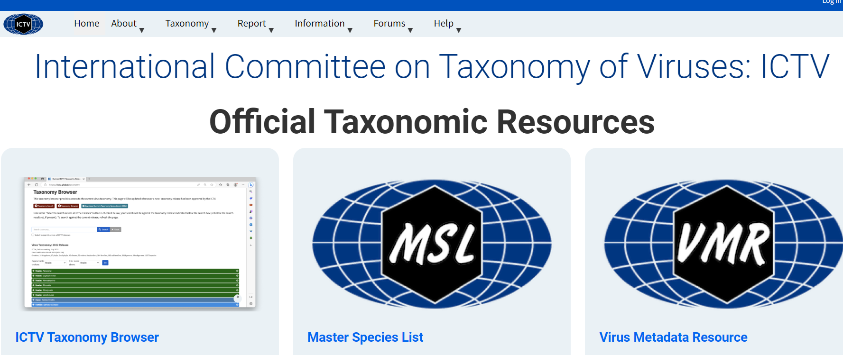
International Committee on Taxonomy of Viruses: ICTV
https://ictv.global/
ICTV officially supervises viral taxonomy.
It is composed of groups of experts for different virus orders/families.

Slide 16
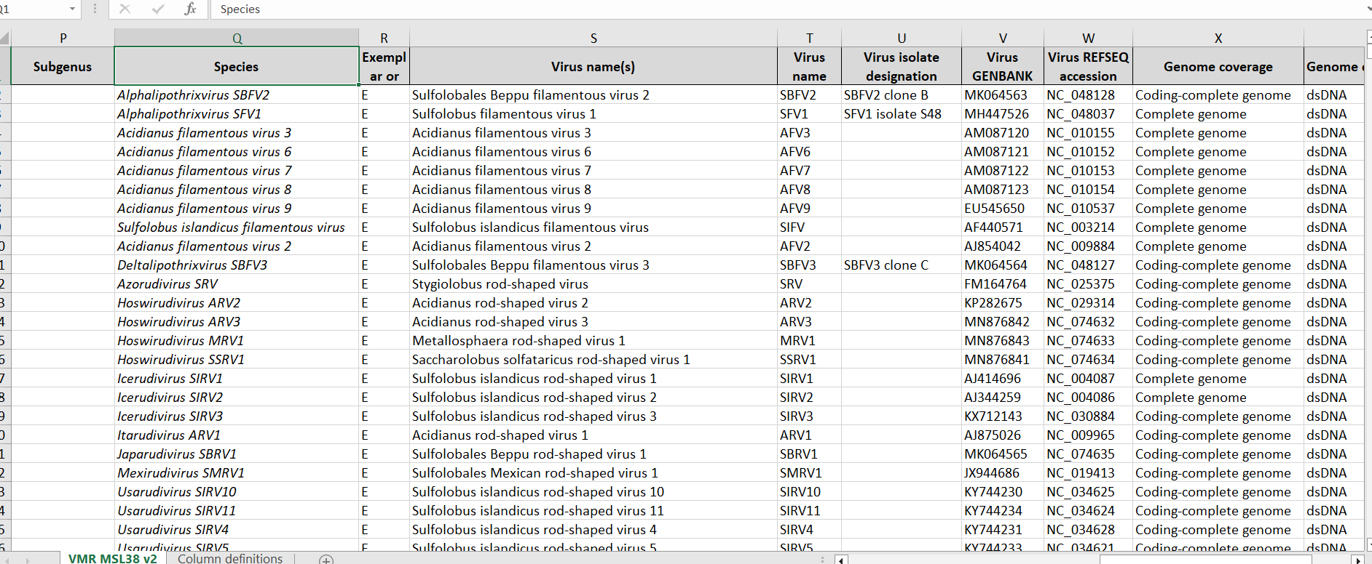
Virus Metadata resource
It provides an exemplar virus for each species, with current name and acronym

Slide 17
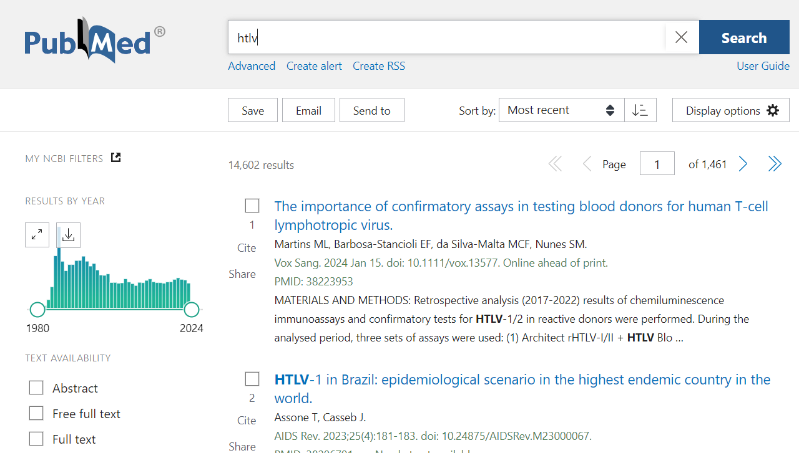
Virus name can be different to taxonomic name
Current virus metadata
primate T-lymphotropic virus 1 | PTLV1
primate T-lymphotropic virus 2 | PTLV2
primate T-lymphotropic virus 3 | PTLV3
History of names (ViralZone)
Primate T-lymphotropic virus 1 | PTLV-1 | HTLV-1, STLV-1 | Human T-lymphotropic virus-1, Simian T-Lymphotropic virus-1
Primate T-lymphotropic virus 2 | PTLV-2 | HTLV-2, STLV-2, STLV-PP | Human T-lymphotropic virus-2, Simian T-Lymphotropic virus-2, Simian T-Lymphotropic virus-PP
Primate T-lymphotropic virus 3 | PTLV-3 | STLV-3 | Simian T-Lymphotropic virus-3
https://viralzone.expasy.org/resources/Acronyms.xlsx

Slide 18

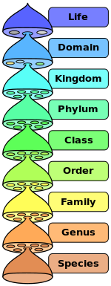
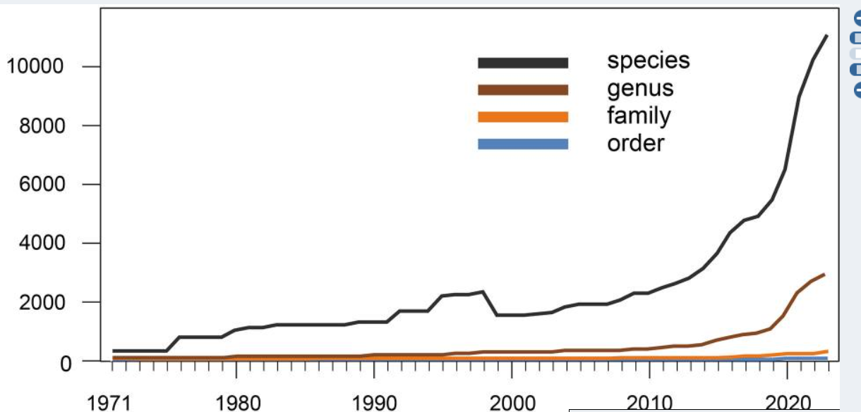
Taxonomic classification is linked to evolution
Cells
Classical classification of Viruses
Life?
…
Baltimore
Genotypes/serotypes
Isolates
Realm

Slide 19
ICTV realm classification
Adnaviria
Monodnaviria
Ribozyviria
HUH endonuclease
alpha-helical
major capsid protein
Riboviria
Duplodnaviria
RdRp and reverse transcriptases
HK97-fold major capsid
Varidnaviria
Classification based on Virus Hallmark Genes (VHGs), which are responsible for the key functions in virus replication and virion morphogenesis
jelly roll major capsid protein

Slide 20
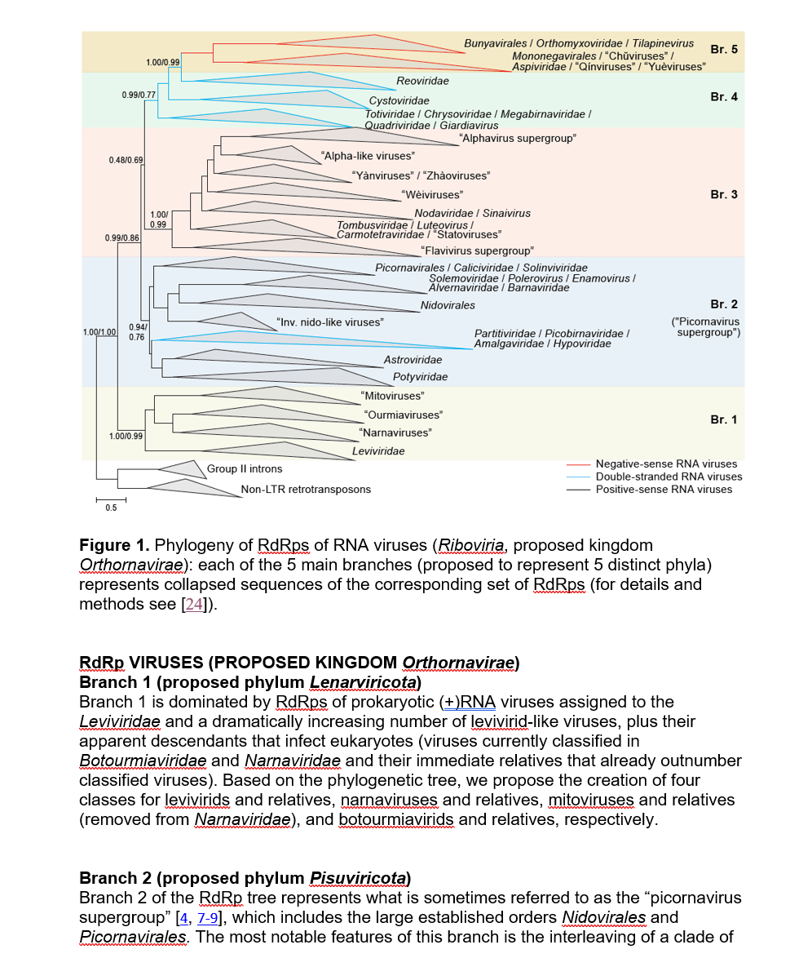
RNA viruses now classified based on Polymerase homology

Slide 21
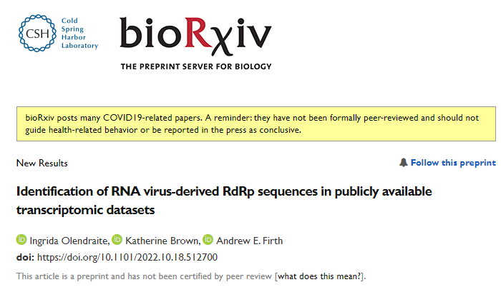
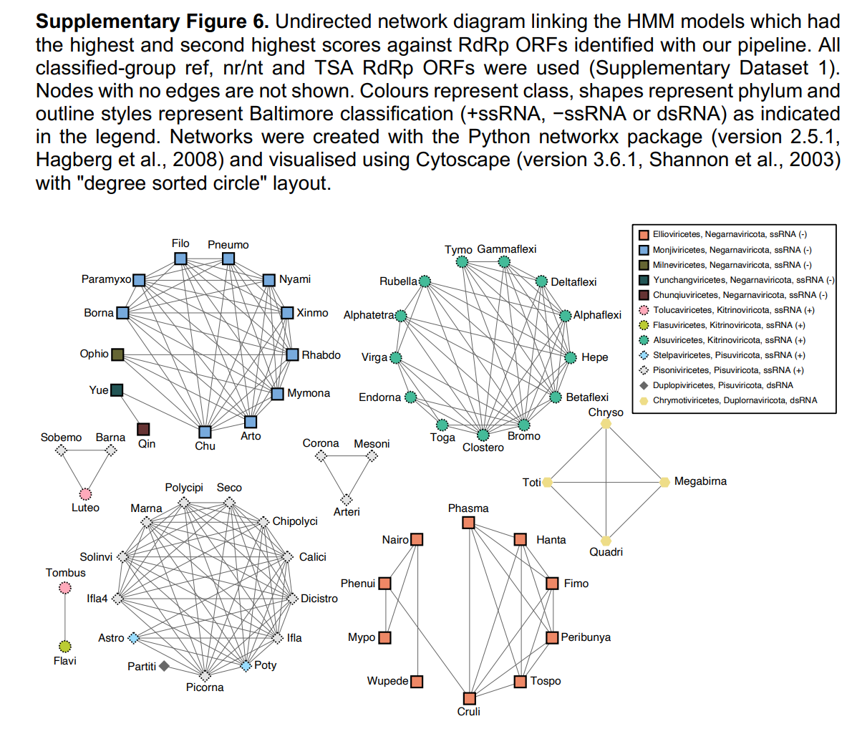
Several classes of RdRP

Slide 22
Below species classification
Cells
Classification below species is necessary,
but there is no global taxonomy.
Experts communities maintain different
classifications for each virus
Life?
…
Baltimore
Genotypes/serotypes/clades
Strains, Variants
Isolates

Slide 23
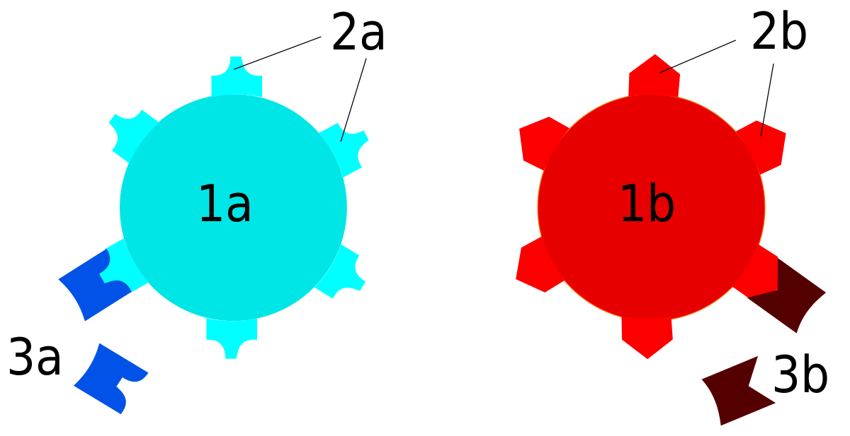
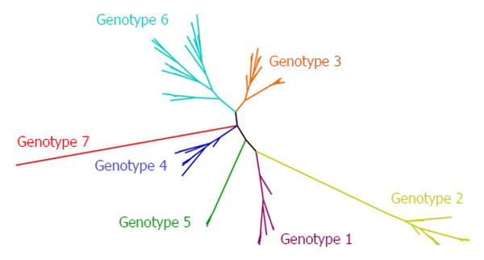
Below species classification
Genotypes vs serotypes
Serotype refers to antibody repertoire binding
Genotype/Clade/Lineages refers to sequence similarity

Slide 24
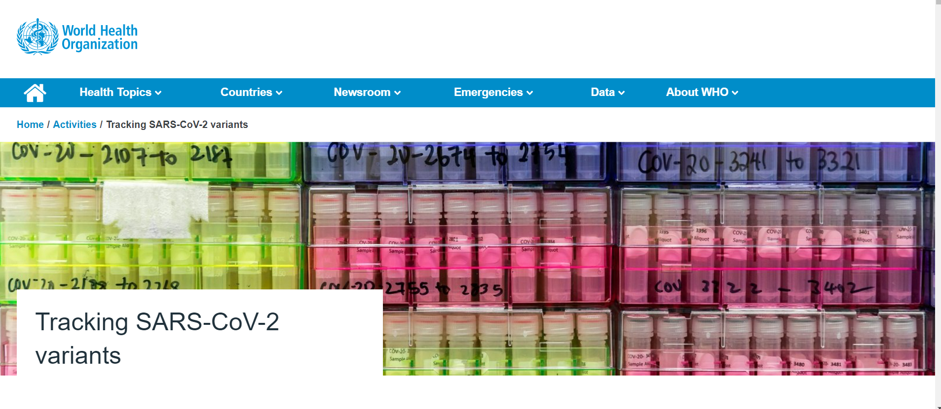
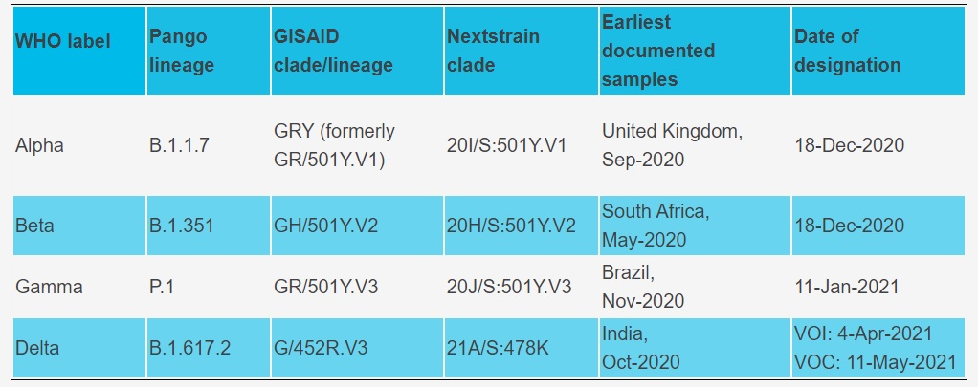
No official naming can create confusion

Slide 25
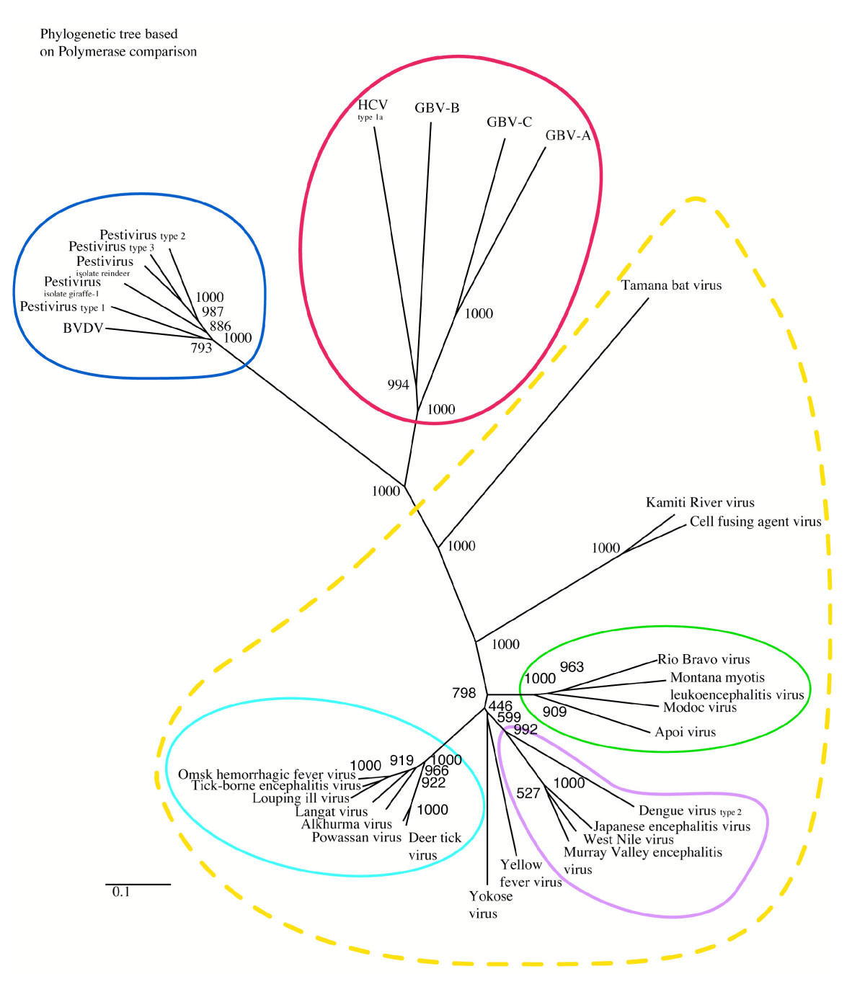
Classification changes as we learn
Hepacivirus
Pestivirus
Flavivirus

Slide 26

Virus metadata
Host
Date of collection
Location of collection
Disease
<paste your data class>

Slide 27
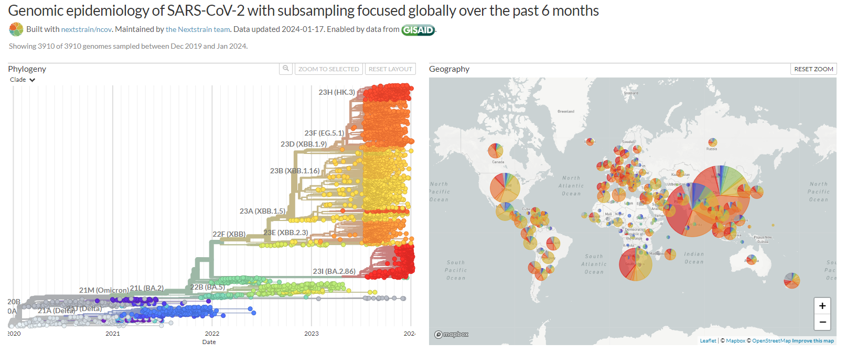
Metadata is essential for epidemiological studies

Slide 28
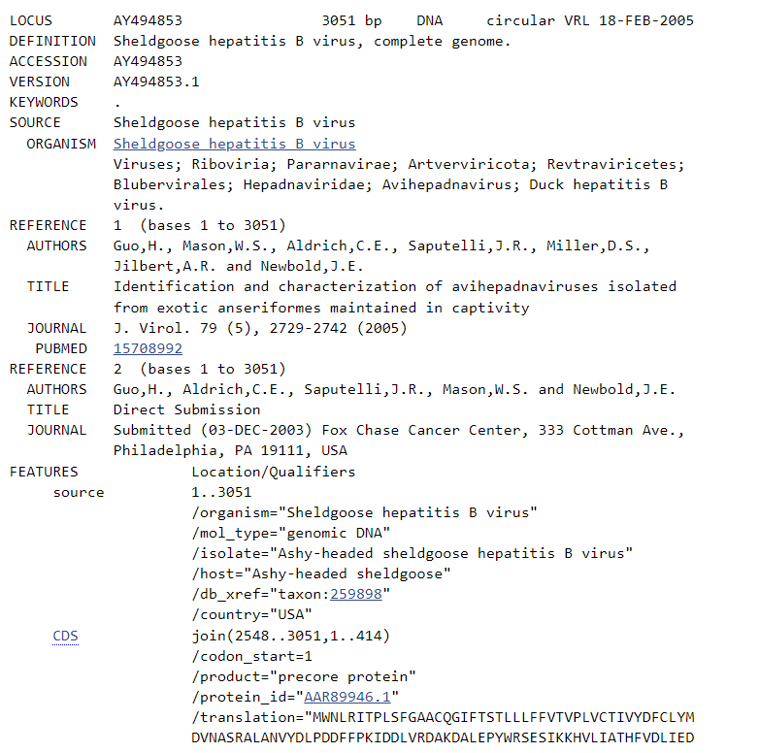
Metadata collection
Facultative in Genbank,
and no controlled vocabulary

Slide 29
Isolates nomenclature
Influenza viruses: Since 1971, Influenza virus isolates have been named according to a system devised by the World Health Organization (1), as follows:
Antigenic type / Isolation host / Location of sampling / Isolate ID code/ Year of sampling
Ex: Influenza A/human/H1N1/Puerto Rico/8/1934
Caliciviridae: A naming system was established in 2000 for caliciviridae (2), using a format similar to the influenza model:
Isolation host / Genus / Species / Isolate ID code/ Year of sampling/ Location of sampling
Ex: Hu/NLV/I/Norwalk/1968/US
Geminiviridae: A system of standardized Geminivirus names was adopted in 2005 to handle the increasing number of sequences (3):
Virus species name [Country of origin : Isolate ID code: Isolation host : Year of sampling]
Ex: Maize streak virus, A [Uganda: Kas42: (isolation host??): 2005]

Slide 30
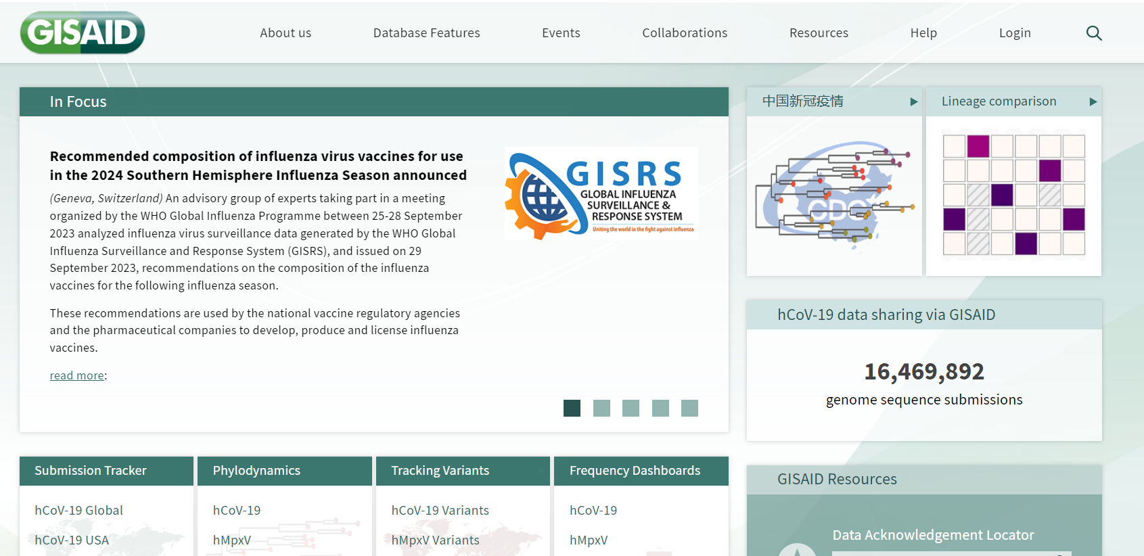
We need dedicated repository to structure viral genetic data
GISAID is an example of repository
Designed to structure viral data.
It was developed first for influenza viruses, then adapted to Coronavirus and Monkeypox.

Slide 31
Introduction to Viral Bioinformatics
Generalities
Virus resources/database
Viral genomics
Viral metagenomics
Viral Proteomics
Host-virus interactions

Slide 32

Virus Resources/databases
ViralZone
VipR- BV-BRC
(NCBI/Genbank)
(Nextstrain)
(UniProt)
(Viruses string)
Overview of databases
https://www.mdpi.com/1999-4915/15/9/1834

Slide 33


ViralZone resource:
viralzone is a resource that links virus sequences with knowledge
Linking sequence and knowledge
https://viralzone.expasy.org/

Slide 34
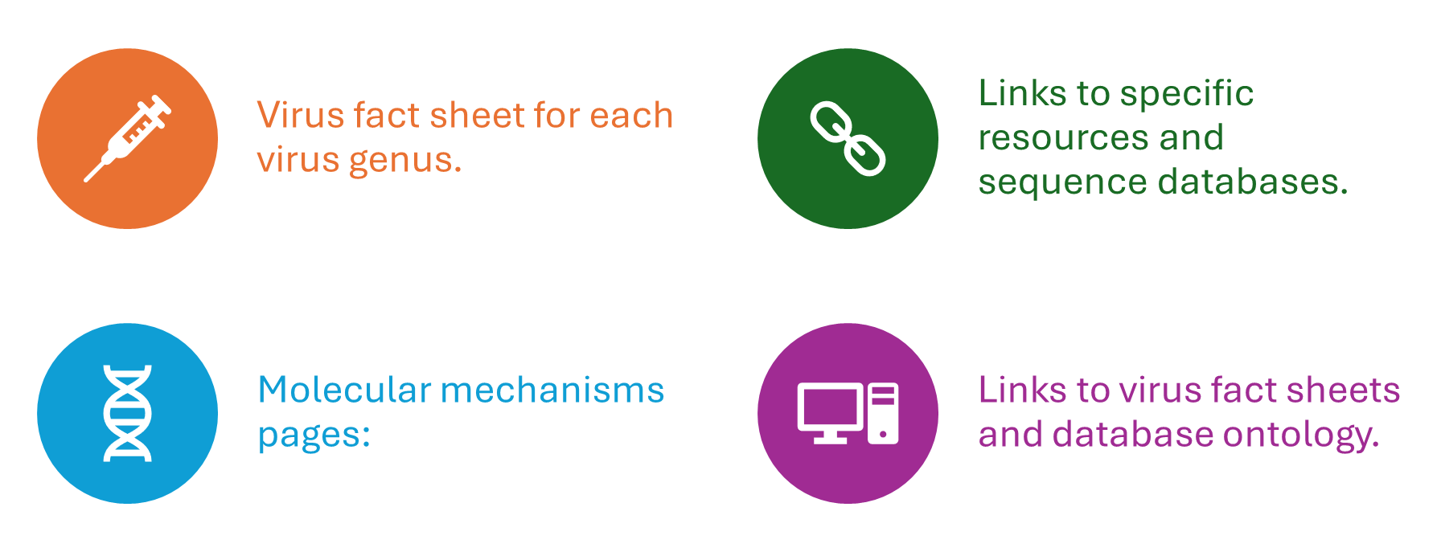
KNOWLEDGEBASE: ViralZone

Slide 35
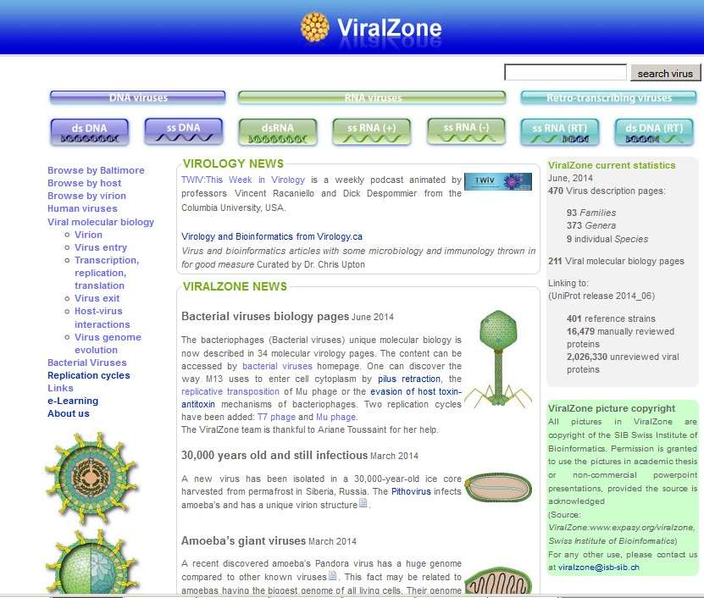
ViralZone homepage
Taxonomy
Molecular processes
Replication cycles

Slide 36
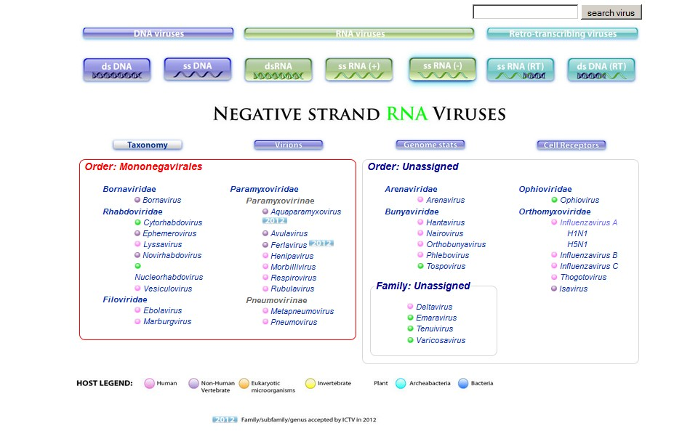
Taxonomic view of Baltimore class
ICTV

Slide 37
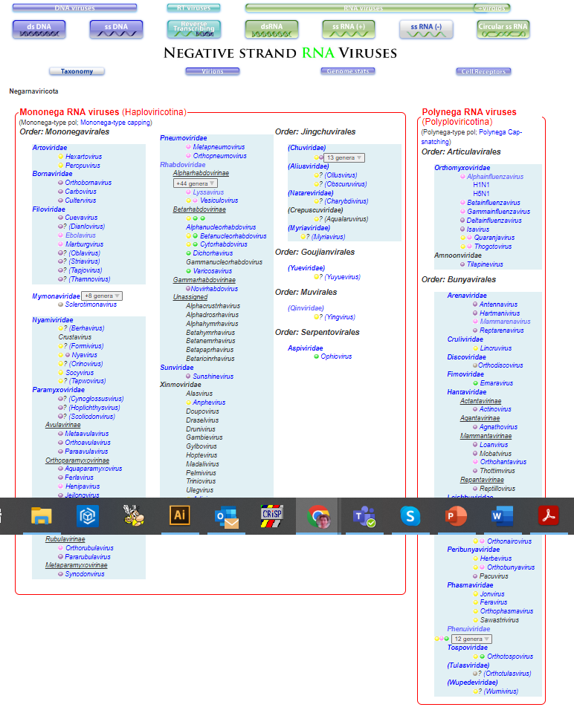
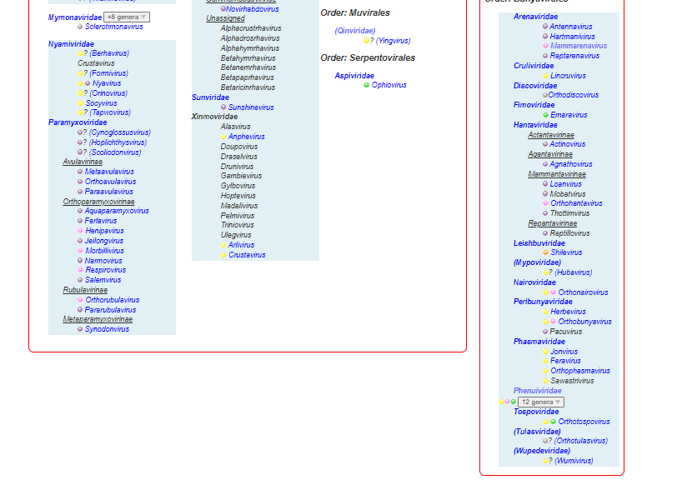
Taxonomy changes
2008
2024

Slide 38
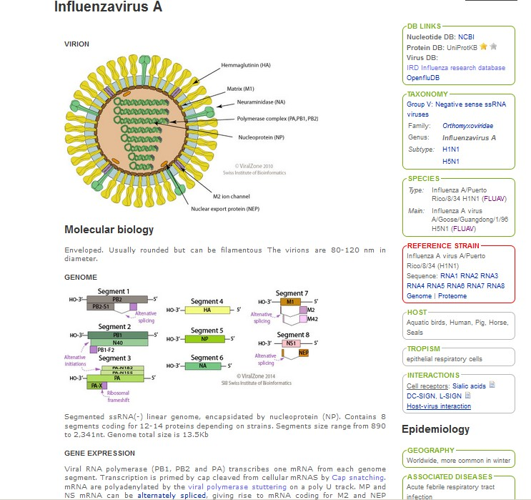
Virus Fact sheet
Virion
Genome

Slide 39
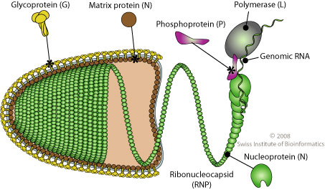
ViralZone pictures
More than 400 pictures represents the global diversity of virions
Those pictures are available for any academic activities

Slide 40
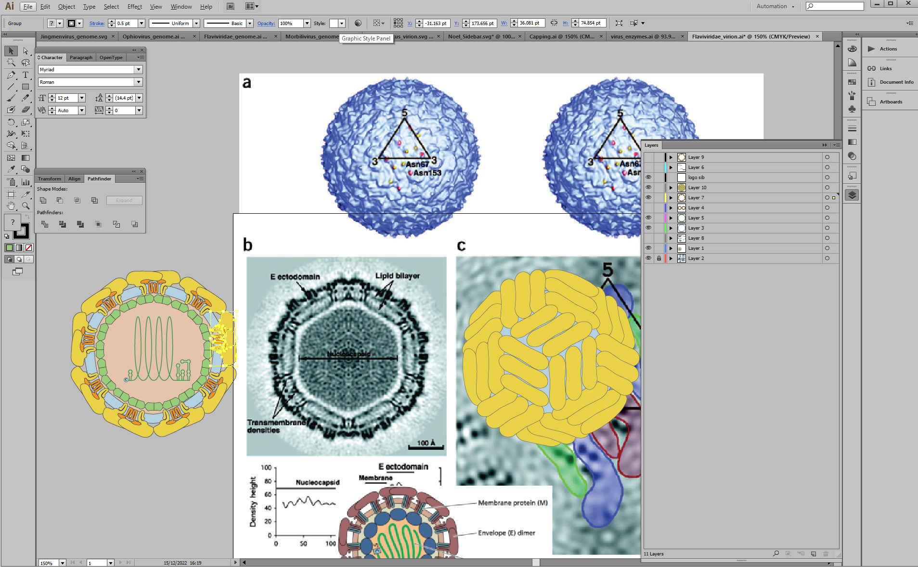
Drawing virions

Slide 41
Virions

Slide 42
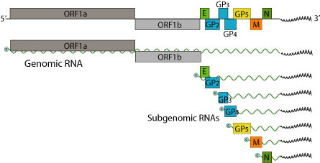
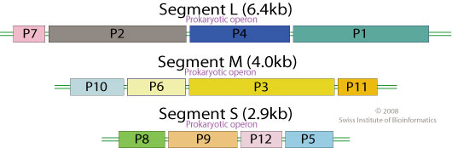
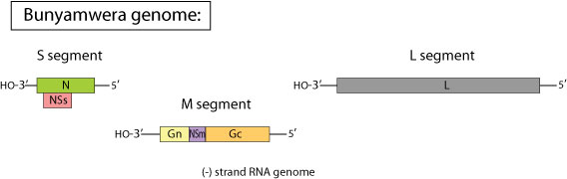
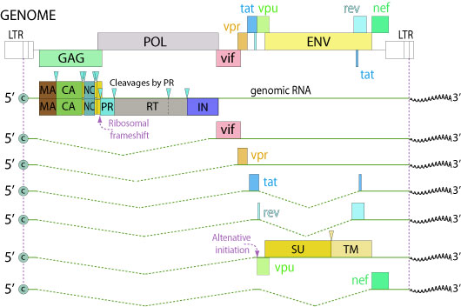
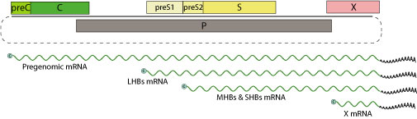

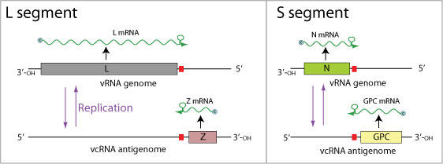



Viral genomes

Slide 43

Pictures are accessible in scalable vector graphics (SVG)
Human virus virions are made interactive with genome

Slide 44

Virus entry processes

Slide 45

Replication, transcription and translation
Cells

Slide 46

Virus exit

Slide 47

Host-virus interactions

Slide 48

Molecular process page

Slide 49

Molecular processes and ontology

Slide 50



Molecular pages and virus fact sheets are linked
Virus fact sheet
Cap snatching

Slide 51

Replication cycles
Adenovirus, Poxvirus, Rotavirus, Poliovirus,
HIV-1, HBV, Mu, T7, Lambda, Inovirus
Pop-ups

Slide 52


Conclusion
ViralZone is a resource under constant development
Virus description pages:
158 Families
711 Genera
352 Viral molecular biology pages
Visited by more than 30,000 unique visitors/ months from all over the world

Slide 53




ViralZone team
Philippe Le Mercier
Virus team leader
Patrick Masson
Virus team annotator
Chantal Hulo
Virus team annotator
Edouard de Castro
Programmer
SwissProt direction:
Alan Bridge

Slide 54

DATABASE:
GenBank/ EMBL/ DDBJ
« different views of the same data set »
http://www.insdc.org/
These three databases contain all published sequences.
They work together since more than 20 years.
Data submissions can be made at either of the three portals.

Slide 55



Growth of GenBank
Genbank, WGS
Sequence read archive
Next generation sequencing,
Whole genome sequencing
Sanger sequence
 |  | Sequences: 240 millions
WGS= Whole genome shotgun
 |  | Sequences: 2.2 billions
Notes:
http://www3.ebi.ac.uk/Services/DBStats/

Slide 56

GenBank sequence entry
Title
Header:
Accession number
Taxonomy
References (depository, publications)
Features
(optional)
Source and metadata
Sequence features
ORF
Protein sequences
Sequence: partial or complete genome

Slide 57

GenBank contains raw data
The database is a sort of museum of sequences, where sequences are kept as they were submitted, interpreted and published by the authors
Entries can only be modified by authors.

Slide 58

Submission 101
Users should pay attention to assotiate all sampling and clinical metadata to their sequence
Editing/modification of the deposited sequence belongs to the depositor
All sequences not deposited are going to be lost in the long term

Slide 59



Numbers of SARS-COV-2 genomes available in either GISAID or INSDC per country on May 31, 2022
11 million SARS-CoV-2 genomes deposited in GISAID
INSDC databases had approximately half that number (~5.5 million).
(May 2022)
Switzerland submits to both databases, thanks to SPSP (SIB)!

Slide 60

All taxonomy in Databases refers to NCBI taxonomy
The main problem is that submitters are not always up to the task of
describing the correct taxonomy.
The result is a melting pot of good and bad taxonomy

Slide 61

RefSeq viruses

Slide 62
RefSeq entry
Title
Header:
Accession number
Taxonomy
References (depository, publications)
Features
Curated
by experts
Source and metadata
Sequence features
ORF
Protein sequences
Complete genome sequence

Slide 63

NCBI Virus variation resource

Slide 64


Slide 65


NCBI virus
A resource trying to order GenBank viral sequence mess
https://www.ncbi.nlm.nih.gov/labs/virus/vssi/#/

Slide 66
DATABASE:
Bacterial and Viral Bioinformatics Resource Center (BV-BRC)
https://www.bv-brc.org/view/Virus/10239
NIH/NIAID-funded free bioinformatics database online
Bioinformatics Resource Centers (BRC) contract
Integrated data from various sources
Suite of data analysis and visualization tools

Slide 67

BV-BRC virus

Slide 68

Taxonomic view of sequences

Slide 69

Easy genome browsing

Slide 70

Epitopes

Slide 71

The site offers plenty of virus tools

Slide 72

Search with metadata

Slide 73
BV-BRC summary
Summary
Free and open access with no use restrictions
Developed by a team of research scientists, bioinformaticians and professional software developers
Comprehensive collection of public data
Novel derived data, novel analytical tools, unique functions
New tools and new data driven by user requests
Training and support

Slide 74



UCSC Genome browser
https://genome-euro.ucsc.edu/cgi-bin/hgGateway?redirect=manual&source=genome.ucsc.edu

Slide 75

European Virus Bioinformatics
WEB resource
Virus Bioinformatics research excellence and innovation with deep impact for a better, healthy world.
https://evbc.uni-jena.de/

Slide 76

European virus bioinformatics center
Membership
Publications
Tools
Events (virus bioinformatics meeting)

Slide 77

Virus Bioinformatics Meeting (ViBiom)

Slide 78
Introduction to Viral Bioinformatics
Generalities
Virus resources/database
Viral genomics
Viral metagenomics
Viral Proteomics
Host-virus interactions

Slide 79

Viral genomics
Viral genome evolution and diversity
Genomic drift
Recombination, reassortment
Strains, isolates, variants, quasispecies

Slide 80

Viral sequence space is huge and diverse
13 085 774 viral sequences in Genbank (including 8,647,826 SARS-CoV-2) [Jan 2024]
78,618 complete genomes, comprising 333,861 sequences (ViralZone 2020)
But about 119 type of virus known to infect humans...

Slide 81

The red queen reigns in the kingdom of viruses
Red queen effect: Co-evolutionary equilibrium in which the hosts constantly evade the viruses, while the viruses also mutate in order to maintain their virulence.

Slide 82

The Red Queen effect leads to instability of the viral genome.
Host genome and acquired immunity evolve to resist the virus
Constant evolution can lead to infecting a new host
The virus co-evolve and can “jump” by the creation of new variants.

Slide 83



Genomic heterogeneity at species level
PASC (PAirwise Sequence Comparison) is a web tool for analysis of pairwise identity distribution within viral families.
https://www.ncbi.nlm.nih.gov/sutils/pasc/viridty.cgi?textpage=overview

Slide 84



Genomic heterogeneity at species level
PASC (PAirwise Sequence Comparison) is a web tool for analysis of pairwise identity distribution within viral families.

Slide 85


Anelloviridae

Slide 86
Viral genome evolution
https://viralzone.expasy.org/4136
Genetic drift:
Random mutation by replication error
Nucleic acid damage
Cellular editing
Genetic shift:
Recombination by crossing over
Reassortment (segmented virus)

Slide 87

Random mutation by replication errors
Viral polymerases are more error prone than cellular polymerases, with the least accurate being viral RNA-dependent RNA polymerases

Slide 88

Genetic drift by cellular editing
Host cellular defence enzymes are mutating cytoplasmic nucleic acids.
This can attenuate and kill the virus or allow it to evolve faster.
“What doesn’t kill you, makes you stronger” Friedrich Nietzsche

Slide 89



The dynamic of SARS-CoV-2 mutations
From: An early warning system for emerging SARS-CoV-2 variants
Nature Medicine (May 2022)
From: Omicron: What Makes the Latest SARS-CoV-2 Variant of Concern So Concerning?
Virology, Gem, 23 March 2022

Slide 90

Genetic shift: recombination
Recombination occurs when two closely related viral genomes recombine by homologous crossing over.
This happens for DNA viruses and is very common in prokaryotic viruses.
Some RNA viruses also evolve by recombination

Slide 91

Genetic shift
Reassortment
Reassortment occurs event when two similar segmented viruses exchange part of their genomes during a cell co-infection

Slide 92

Reference sequence
Most virus studies requires reference sequences
Refseq(NCBI)
Others

Slide 93

SARS-CoV-2 variants
2027 different lineages identified by PANGO (June 2022)
(https://cov-lineages.org/)
BA.1
BA.2.12.1
BA.2
BA.4
BA.5
Alpha
Delta
Beta

Slide 94


Choosing the right mutations!
WHO gives names, but no sequence.
Many mutations occur within a lineage. We choose to consider those that are observed in >80% of sequences (https://outbreak.info/).

Slide 95


Variants in ViralZone
Description of amino acid variations
Links to PANGO, CoVariants.org
outbreak.info
Links to reference genomes /proteins
Chosen with NCBI, ViPR
https://viralzone.expasy.org/9556

Slide 96

Variant annotation in Swis-Prot
We annotate the WHO named variants in Swiss-Prot with FT VARIANT in the Wuhan 2020 reference proteome.

Slide 97

Genome landscape representation
Phylogenetic trees
PCA analysis

Slide 98

Phylogenetic tree
Sequences .fasta
Multiple sequence Alignment
The differences between aligned sequences of genomes or proteins can be quantified and depicted in the form of a tree.
Caution: deletions and recombination are not well represented by this technique.
Alignment .aln (clustal, fasta,…)
Multiple sequence Alignment
E-learning on MSA and Phylogenetic trees:
https://viralzone.expasy.org/5576
Phylogenetic tree .tree .nwk (Newick)
https://viralzone.expasy.org/resources/FMV/SARStest.fasta

Slide 99


PCA analysis: H1N1 influenza
Human
2009 swl
1978-99
2000-18
1948-50
1933-47
Human
Eurasian Swine
Avian
Classical Swine

Slide 100
Tolls: Genotypers
Genotypers are tools to identify virus subtype automatically
http://dbpartners.stanford.edu/RegaSubtyping/html/

Slide 101
Genotype for segmented virus?

Slide 102
Viral genomics: Nextstrain

Slide 103
Tools: Nextstrain
Nextstrain is a collaboration between researchers in Seattle, United States and Basel, Switzerland (2015)
Visualising the genetics behind the spread of viral outbreaks.
  https://nextstrain.org

Slide 104
Nextstrain: Parts of a whole
Augur
Auspice
Analysis
Visualization
https://docs.nextstrain.org/en/latest/learn/parts.html

Slide 105
Datasets are produced by Augur and visualized by Auspice
These files are referred to as JSON because they use a generic data format called JSON
https://docs.nextstrain.org/en/latest/learn/parts.html

Slide 106
Auspice translate data text files into colored tree

Slide 107
Exploring interactive phylogenies with Auspice
Phylogeny panel
Map
Diversity panel

Slide 108


Phylogeny panel

Slide 109

Diversity panel
it enables the observation of mutations and the visualization in the phylogenetic tree

Slide 110


Mutation event visualization

Slide 111

Looking at a protein’s position

Slide 112

Builds are recipes of code and data that produce these datasets
https://docs.nextstrain.org/en/latest/learn/parts.html

Slide 113

Nextstrain build easy to run when new sequence available
Set of commands, parameters and input files to perform bioinformatic analyzes reproducibly and generate an output file for visualization
Allows the user to frequently run different analysis workflows or data sets:
  Only your lab’s data
  Your data AND data from public repositories
Nextstrain’s focus on providing a real-time snapshot of evolving pathogen populations necessitates a reproducible analysis that can be rerun when new sequences are available
https://docs.nextstrain.org/en/latest/tutorials/SARS-CoV-2/steps/orientation-workflow.html

Slide 114

Workflow bundles one or more builds

Slide 115


Main Nextstrain workflows:
Pathogens

Slide 116

Nextstrain community

Slide 117
Nextstrain documentation
A Getting Started Guide to the Genomic Epidemiology of SARS-CoV-2
  Template and tutorial walks through the process of running a basic phylogenetic analysis on SARS-CoV-2 data, specifically to enable Departments of Public Health to start using Nextstrain to understand their SARS-CoV-2 genomic data
  https://docs.nextstrain.org/en/latest/tutorials/SARS-CoV-2/steps/index.html#a-getting- started-guide-to-the-genomic-epidemiology-of-sars-cov-2
Analysis:
Visualization and interpretation:
Setup and installation
Preparing your data
Orientation: analysis workflow
Orientation: which files should I touch?
Running & troubleshooting
Customizing your analysis
Customizing your visualization
Options for visualizing and sharing results
Interpreting your results
Writing a narrative to highlight key findings

Slide 118

Summary
Nextstrain is a powerful tool for analyzing genomic data of pathogens and better understanding epidemiology
Design focus on real-time snapshots of evolving pathogen populations through reproducible analysis (augur)
Features interactive web application for visualization (auspice)
TONS of documentation and tutorials at https://nextstrain.org

Slide 119

Nextclade
Nextclade is an open-source project for viral genome alignment, mutation calling, clade assignment, quality checks and phylogenetic placement.

Slide 120

Nextclade input page

Slide 121

Results with clade assignment
The result can be explored interactively and exported in tabular file format

Slide 122

Results: mutations
https://viralzone.expasy.org/resources/FMV/genometest.fasta
Mutations in each gene can be explored interactively

Slide 123

Viral genomics case study:
Removing retroviral particles from CHO cells

Slide 124

Example: removing retroviral particles from CHO cells
Problem:
CHO cells used to produce e biopharmaceutical proteins are infected with type C-retrovirus.
It was important to get rid of these particles.

Slide 125

Step1: identifications of endogenous retrovirus (ERV)
Sequencing of viruses: ERV display sequence similarity and high copy number.
Thus, we relied on single‐molecule long‐read PacBio sequencing.
260 viruses identified

Slide 126

What viruses are actually expressed?
The total cellular polyadenylated mRNA was sequenced using Illumina sequencing technology.
->Type C ERV group 1 is overexpressed

Slide 127

How to stop the virus from producing particles?
Knowledge: retrovirus uses ESCRT cellular function to bud out of the cell at plasma membrane
https://viralzone.expasy.org/1536?outline=all_by_species

Slide 128


A motif in P12 gag is essential for the budding

Slide 129

GAG protein myristoylation is essential for budding

Slide 130

CRISPR removal of Myr and PPYP region
PATENTS:
-PCT/EP2016/082567 - IMPROVED EUKARYOTIC CELLS FOR PROTEIN MANUFACTURING AND METHODS OF MAKING THEM
-US PPA 62784566 - CHARACTERIZATION AND INACTIVATION OF ENDOGENOUS RETROVIRUSES IN CHINESE HAMSTER OVARY CELLS

Slide 131
Introduction to Viral Bioinformatics
Generalities
Virus resources/database
Viral genomics
Viral metagenomics
Viral Proteomics
Host-virus interactions

Slide 132

Viral metagenomics
Principle
Reference sequences
Virus discovery
Clinical metagenomics

Slide 133

Principles
Assembly may be problematic for
redundant sequences: Long read technologies
Requires reference sequences
and classification tools

Slide 134

Reference sequences for metagenomics
There are two kinds of references
    -> for annotation
    -> for genetic diversity

Slide 135

Reference for annotation:
Reference
Puerto rico 1934
One for all

Slide 136

References for annotation
Nucleic acid references:
NCBI RefSeq :11679 complete genomes in 01/24
Proteomic references
UniProt reference proteomes, all viruses

Slide 137
Reference for sequence diversity
At least 9 representative
Sequences (cutoff 90%)

Slide 138

References for sequence diversity
Representative sequences are standards of sequence diversity
Example: UniRef:

Slide 139

Sequence clustering to reduce redundency

Slide 140


Trimming the branches
223 sequences in GenBank
54 clusters at 95% similarity

Slide 141

Complete genomes
There are different flavors of what is considered to be a complete genome:
-Full length complete (sometimes tricky for linear viruses)
-CDS complete
Full length complete genome
CDS genome

Slide 142


NCBI is not consistent for viral genome completeness
Classified
incomplete
Example: Tibrovirus; 11 complete according to NCBI virus genome.
In reality there are more than 15
Classified
complete
Classified
incomplete
Classified
incomplete
Classified
incomplete
All those sequences have a perfect complete CDS set

Slide 143



Genbank
Complete
Incomplete

Slide 144

Reference databases(1)
 | Clinical metagenomic | Virus discovery
RefSeq | +/- | +/-

Slide 145


Reference databases(2)
 | Clinical metagenomic | Virus discovery
RefSeq | +/- | +/-
RVDB, (Virosaurus) | +++ | ++

Slide 146

Reference databases(3)
 | Clinical metagenomic | Virus discovery
RefSeq | +/- | +/-
Nucleotide: RVDB, Virosaurus | +++ | ++
Protein: RVDB prot | ++ | +++

Slide 147
Virosaurus workflow
Data collection
Complete genome
selection
Clinical annotation
Clustering

Slide 148
Data collection

Slide 149
Complete genome
Complete genomes were identified by size filtering

Slide 150
Annotation and clustering

Slide 151

Annotation
>AB538468:AB538468; usual name=Influenza A virus; clinical level=SPECIES; clinical typing=unknown; species=Influenza A virus; taxid=11320; acronym=IV-A; nucleic acid=RNA; circular=N; segment=3;
AGCGAAAGCAGGGGTTTAAAATGA…..

Slide 152
Annotation

Slide 153
Detection: reads can be mapped to database entries

Slide 154
Annotation and clustering

Slide 155

Virosaurus accessible at ViralZone

Slide 156

Virosaurus diversity statistics

Slide 157

Do we have enough sequences?
Percentage of data reduction after clustering

Slide 158

Virus in clinical metagenomics
The new sequencing technologies allows identifying in one run any pathogens present in a patient sample

Slide 159




Classical detection of viruses
Serology
Polymerase chain reaction (PCR)
You only detect what you are looking for

Slide 160



Detection by next generation sequencing
Bioinformatics
Analysis
Sequencing
Patient
sample
Comparison with
virus reference
Present challenge: the analysis step
(speed, computation),
and having efficient virus references.
Virus?

Slide 161

Toward detecting all pathogens

Slide 162


Tool: Genome detective (aug 2018)
https://www.genomedetective.com/

Slide 163

Genome detective pipeline

Slide 164

Tool: V-Pipe
V-pipe is a bioinformatics pipeline that integrates various computational tools for the analysis of viral high-throughput sequencing data.
It supports the reproducible analysis of genomic diversity in intra-host virus populations, which is often involved in viral pathogenesis and virulence.
Applying V-pipe to SARS-Coronavirus-2 data
https://cbg-ethz.github.io/V-pipe/
https://www.youtube.com/watch?v=pIby1UooK94

Slide 165




Consensus sequence and
SNV
Viral variants
(haplotype)

Slide 166


Slide 167



Slide 168


Slide 169
Availability
Code available on github:
https://github.com/cbg-ethz/V-pipe#using-quick-install-script
Installer for quicker and simpler installation
Relies on snakemake

Slide 170

Case study: blood analysis for Tanzanian children

Slide 171



Slide 172



Blood sample processing
DNA
RNA
(RT)
Reads
CLINIC
FeVir
Mapping to

Slide 173

RNA Viruses of “recognized clinical significance”

Slide 174
DNA Viruses of “recognized clinical significance”

Slide 175
Blood sample processing
Reads
CLINIC
DISCOVERY
FeVir
De novo assembly,
BLAST to U-RVDBv12.2
Mapping to

Slide 176

RNA Viruses of “unknown significance”

Slide 177


RNA Viruses of “unknown significance”
12 patients,
Host: insects!
24 patients
Host: insects!

Slide 178




Virus discoveries?

Slide 179

conclusion
Reads mapped againts curated database provide accurate results.
Although more time-consuming, a de novo approach is recommended in virus discovery
Clinical metagenomics may reveal new human virus entities

Slide 180
Introduction to Viral Bioinformatics
Generalities
Virus resources/database
Viral genomics
Viral metagenomics
Viral Proteomics
Host-virus interactions

Slide 181

Viral proteomics
UniProt
Polyproteins
Viral enzymes-> antivirals
Structural virology :
      (Alphafold)
      (Virus particle explorer)
Disorder
      (Disprot)

Slide 182



UniProt: The proteomics database

Slide 183








The UniProt consortium born is 2002
European Bioinformatics Institute
European Molecular Biology Laboratory
Swiss Institute of Bioinformatics
Protein Information Resource

Slide 184

UniProt web site

Slide 185





UniProtKB entries
CDS
DDBJ/EMBL/Genbank
TrEMBL
Swiss-Prot
Once in Swiss-Prot,
removed from TrEMBL
-> Minimal redundancy

Slide 186






TrEMBL
<->
SwissProt

Slide 187

Global structure of UniProt

Slide 188

UniProt entry
https://www.uniprot.org/uniprotkb/P04616/entry

Slide 189

Names and taxonomy
NCBI taxonomy, based on ICTV
Host taxID(s)

Slide 190

Subcellular location in host and virion
Subcellular location is important for interactomics

Slide 191

PTM/processing

Slide 192

Interactions
Best data available for viruses, but nor parsable

Slide 193

Family and domains

Slide 194


UniProt annotation completes GenBank gene models

Slide 195

What is annotation?
Information associated with sequence is called annotation.
Three flavours:
Free text
Controlled vocabulary
Ontology: controlled vocabulary + hierarchy

Slide 196

HA Annotation: free text
“Binds to sialic acid-containing receptors on the cell surface, bringing about the attachment of the virus particle to the cell. This attachment induces virion internalization of about two third of the virus particles through clathrin-dependent endocytosis and about one third through a clathrin- and caveolin-independent pathway. Plays a major role in the determination of host range restriction and virulence. Class I viral fusion protein. Responsible for penetration of the virus into the cell cytoplasm by mediating the fusion of the membrane of the endocytosed virus particle with the endosomal membrane. Low pH in endosomes induces an irreversible conformational change in HA2, releasing the fusion hydrophobic peptide. Several trimers are required to form a competent fusion pore.”

Slide 197

HA Annotation: controlled vocabulary
Keywords - Molecular function^{i}
Hemagglutinin
Keywords - Biological process^{i}
Clathrin- and caveolin-independent endocytosis of virus by host, Clathrin-mediated endocytosis of virus by host, Fusion of virus membrane with host endosomal membrane, Fusion of virus membrane with host membrane, Host-virus interaction, Viral attachment to host cell, Viral penetration into host cytoplasm, Virus endocytosis by host, Virus entry into host cell

Slide 198

Annotation: UniProt Keyword

Slide 199



Annotation: ontology

Slide 200
Gene Ontology (GO)
URL: http://www.geneontology.org/
Gene Ontology is
A hierarchy of roles of genes and gene products independent of any organism.
Composed of three independent ontologies: molecular function, biological process, cellular component
GO itself does not contain any information on genes or gene products

Slide 201
Viral polyproteins
Many RNA viruses encode for big polyproteins (>30 viral families)
Retroviridae (HIV)
Flaviviridae (Yellow fever virus, Zika virus,…)
Picornaviridae (Enterovirus, Rhinovirus, Poliovirus)
Coronaviridae (SARS, MERS)
Togaviridae (Chikungunya)

Slide 202

Viral polyproteins
Polyprotein is a way to express many proteins functions using a single gene/ORF.

Slide 203


Polyprotein annotation in UniProt in one entry

Slide 204

Issues with one entry polyprotein
The polyprotein has keywords, features of 10+ different functional proteins, same with GO annotation
Publications often refer to a single protein , numbered by chain
3D structure are made and numbered by chain

Slide 205

Replicase protein 1ab SARS-CoV-2
https://www.uniprot.org/uniprotkb/P0DTD1/entry
Contains 16 proteins
1402 structures
615 GO annotations
76 interpro domains
53 keywords

Slide 206

Structural virology

Slide 207


Primary database:
Protein Data Bank
Worldwide consortium since 1971
Methods: X-ray Crystallography , NMR, Electron Microscopy and other methods
Statistics
Example: Neuraminidase complex

Slide 208

Structural virology
https://viralzone.expasy.org/885

Slide 209

Viral Capsid are defined by ther T number

Slide 210
PDB-101 Viruses offers views of viral structures
https://pdb101.rcsb.org/browse/viruses

Slide 211
Virus particle explorer
https://viperdb.org/

Slide 212
Alphafold

Slide 213
Alphafold database does not contains viruses
https://alphafold.ebi.ac.uk/faq#faq-4

Slide 214
Using AlphaFold Predictions in Viral Research
Example: A study evaluated the binding of antiviral drug tecovirimat to Monkeypox F13 gene
https://www.ncbi.nlm.nih.gov/pmc/articles/PMC10136805/

Slide 215
Disorder
Disordered proteins play a major role in viral biology

Slide 216

Disorder prediction by MobiDB
https://mobidb.bio.unipd.it/

Slide 217
Disprot for curated data

Slide 218

Automatic annotation: SARS-CoV-2 Nucleoprotein

Slide 219
SARS-CoV-2 variants preferentially emerge at intrinsically disordered protein sites
With the disprot group,
We have established that variants occur preferentially at disordered regions
From:SARS-CoV-2 variants preferentially emerge at intrinsically disordered protein sites helping immune evasion.
FEBS J. 2022 Feb 2

Slide 220
Introduction to Viral Bioinformatics
Generalities
Virus resources/database
Viral genomics
Viral metagenomics
Viral Proteomics
Host-virus interactions

Slide 221
Host-virus Interactions
Virus host interactions
Large scale interactomes

Slide 222
Virus hosts
(2021)
https://www.genome.jp/virushostdb/note.html

Slide 223
Virus hosts
https://www.genome.jp/virushostdb/note.html

Slide 224
Virus-Host DB gather data from multiple sources

Slide 225
Virus-Host interactions
Data is complex and of mixed quality
Large scale interactome are dificult to interpret

Slide 226
Virus-Host interaction databases

Slide 227
STRING virus
http://viruses.string-db.org/
HIV-1 and Homo sapiens interaction network in viruses

Slide 228
VirHostNet resource
https://virhostnet.prabi.fr/

Slide 229
VirHostNet
Spike SARS-CoV-2

Slide 230
Virus interactomes are complex to analyse
And not reproducible (cell host)
HIV-rev interactome
(116aa)
Epstein-Barr virus interactome
Knowledge integration is key to make the most of this data

Slide 231
The big issue is the cell culture
Transformed cells have their antiviral defenses highly modified
Cell lineage might not be relevant to a natural infection
Overexpressing a viral protein alone out of context brings a lot of entropy

Slide 232
Zika interactome (Nature, sept 2018)

Slide 233
Are host-virus interactions controlled?
Cell survival
matters
Cell survival
does not matter
Interactions strictly
controlled
Interactions weakly
controlled

Slide 234
Virus host interactions
Virus-Host interactions are essential but complicated to study
Large scale analysis result in a lot of false positive: necessity to filter data

Slide 235
Introduction to Viral Bioinformatics
Generalities
Virus resources/database
Viral genomics
Viral metagenomics
Viral Proteomics
Host-virus interactions

Slide 236
Conclusion
Viral bioinformatics requires some expertise and knowledge of virus genetics and data
It plays an important role in virus monitoring, research and therapy
Further information can be found in the resources/tools linked in this course

Slide 237

Thank you
DATA SCIENTISTS FOR LIFE
sib.swiss

